Slide 1
Data Sources
ADHS Opioid Prevention Data: Part of Arizona's health strategy, providing information on preventive measures against opioid misuse and their effectiveness.
The ADHS Opioid Dashboard: A dynamic, interactive tool from the Arizona Department of Health Services. It tracks the state's opioid epidemic through comprehensive data, focusing on opioid use, misuse, and overdose, to guide prevention and response efforts.
CDC Opioid Data: A broad range of vital statistics provided by the Centers for Disease Control and Prevention, which offers national-level information on opioid-related morbidity and mortality. This data assists in understanding the scope, distribution, and determinants of the opioid crisis.
Arizona Prescription Monitoring Program (PMP): A state-wide program designed to monitor the prescribing and dispensing of controlled substances. The PMP helps detect possible misuse or over-prescribing of such medications, aiding healthcare professionals to make informed decisions and ensure patient safety.

Slide 2
Data Sources
ADHS Treatment Capacity Survey Analysis Quarterly Reports (2018-2023):
Under the Arizona Opioid Epidemic Act of 2018, each facility that provides inpatient or outpatient Substance Use Disorder Treatment (SUDT) is required to submit a quarterly report to the Arizona Department of Health Services (ADHS) that includes information regarding the number of days in the quarter that the facility was at capacity and unable to accept referrals for treatment.
For each quarter, different facilities responded to the survey. Of those who responded, some of them reported that they provided at least one type of substance abuse service.
The surveys are distributed through the Division of Licensing Services to reach licensed facilities and through the Arizona Health Care Cost Containment System (AHCCCS).

Slide 3
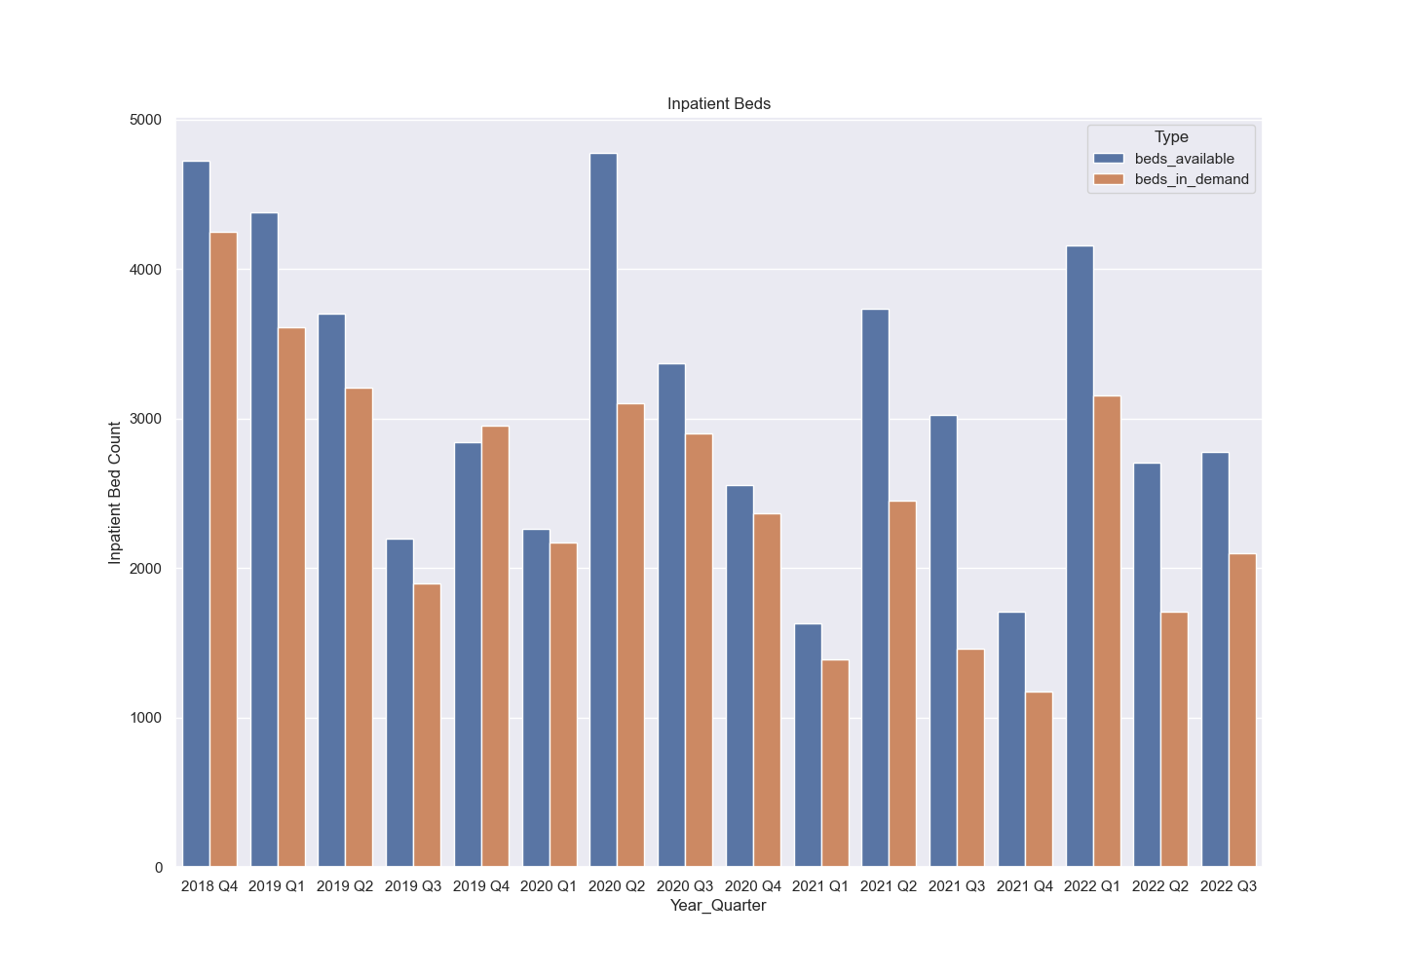
The figure above shows the number of inpatient beds available and in demand at the facilities in Arizona that provide SUDT (based on the facilities that responded to the quarterly surveys conducted by the ADHS)
source: Arizona treatment capacity survey analysis (2018-2022), ADHS

Slide 4
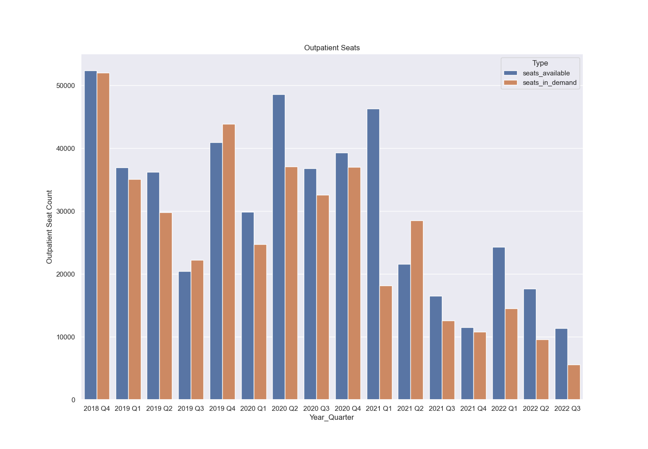
The figure above shows the number of outpatient beds available and in demand at the facilities in Arizona that provide SUDT (based on the facilities that responded to the quarterly surveys conducted by the ADHS)
source: Arizona treatment capacity survey analysis (2018-2022), ADHS

Slide 5
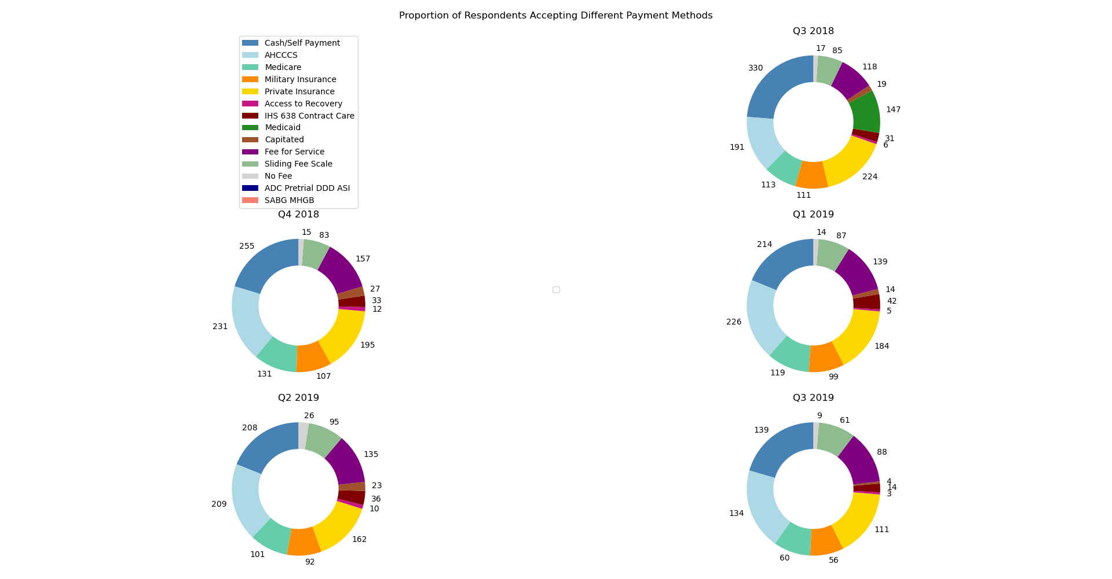
Number of facilities in Arizona accepting different payment/reimbursement methods for the services provided (based on the facilities that responded to the quarterly surveys conducted by the ADHS)
* Respondents could select multiple responses. source: Arizona treatment capacity survey analysis (2018-2022), ADHS

Slide 6
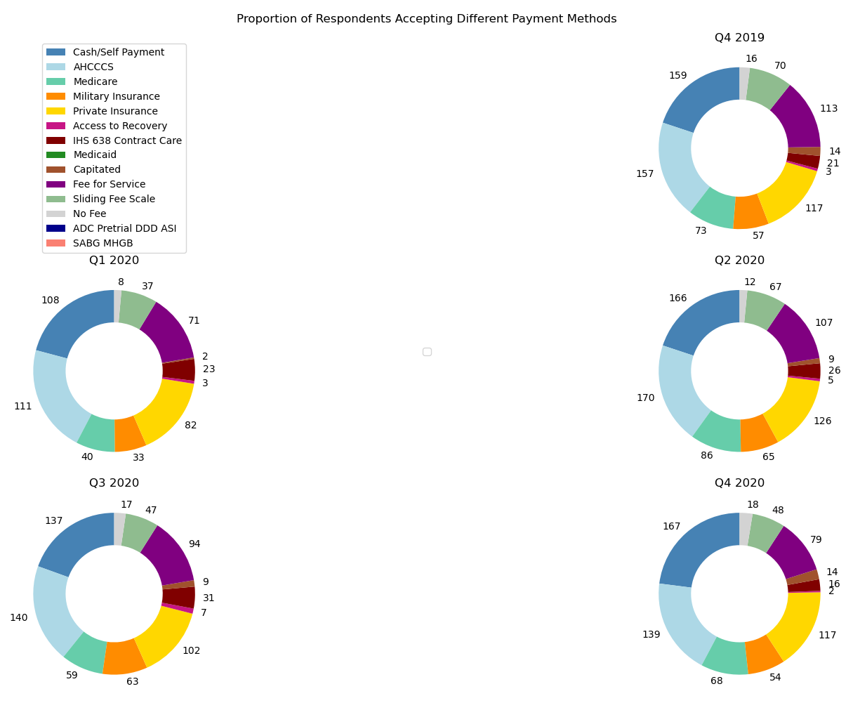
Number of facilities in Arizona accepting different payment/reimbursement methods for the services provided (based on the facilities that responded to the quarterly surveys conducted by the ADHS)
* Respondents could select multiple responses. source: Arizona treatment capacity survey analysis (2018-2022), ADHS

Slide 7
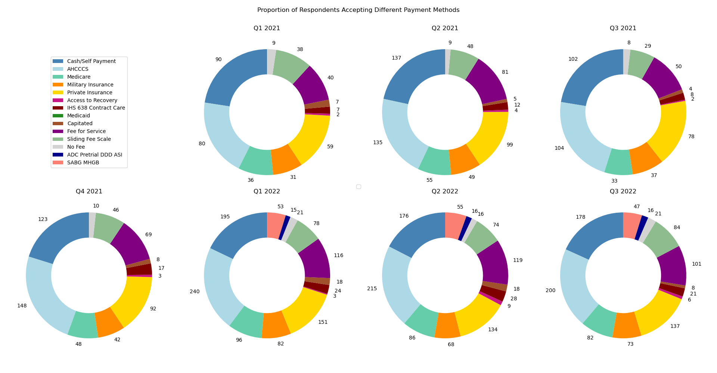
Number of facilities in Arizona accepting different payment/reimbursement methods for the services provided (based on the facilities that responded to the quarterly surveys conducted by the ADHS)
* Respondents could select multiple responses. source: Arizona treatment capacity survey analysis (2018-2022), ADHS

Slide 8
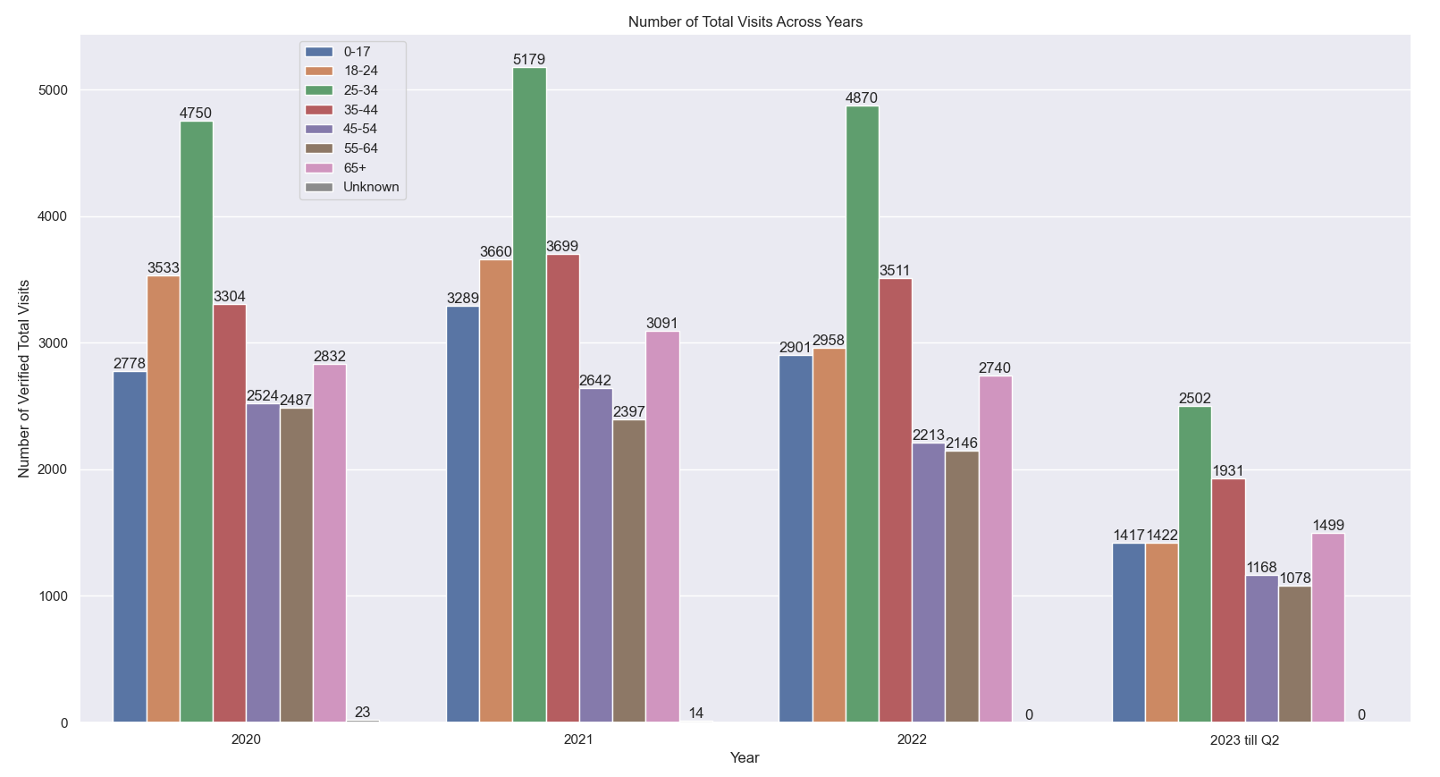
The figure above shows the total visits (emergency + inpatient) for suspected drug overdoses across years in Arizona, aggregated over different age categories.
Source: ADHS-Opioid Prevention

Slide 9
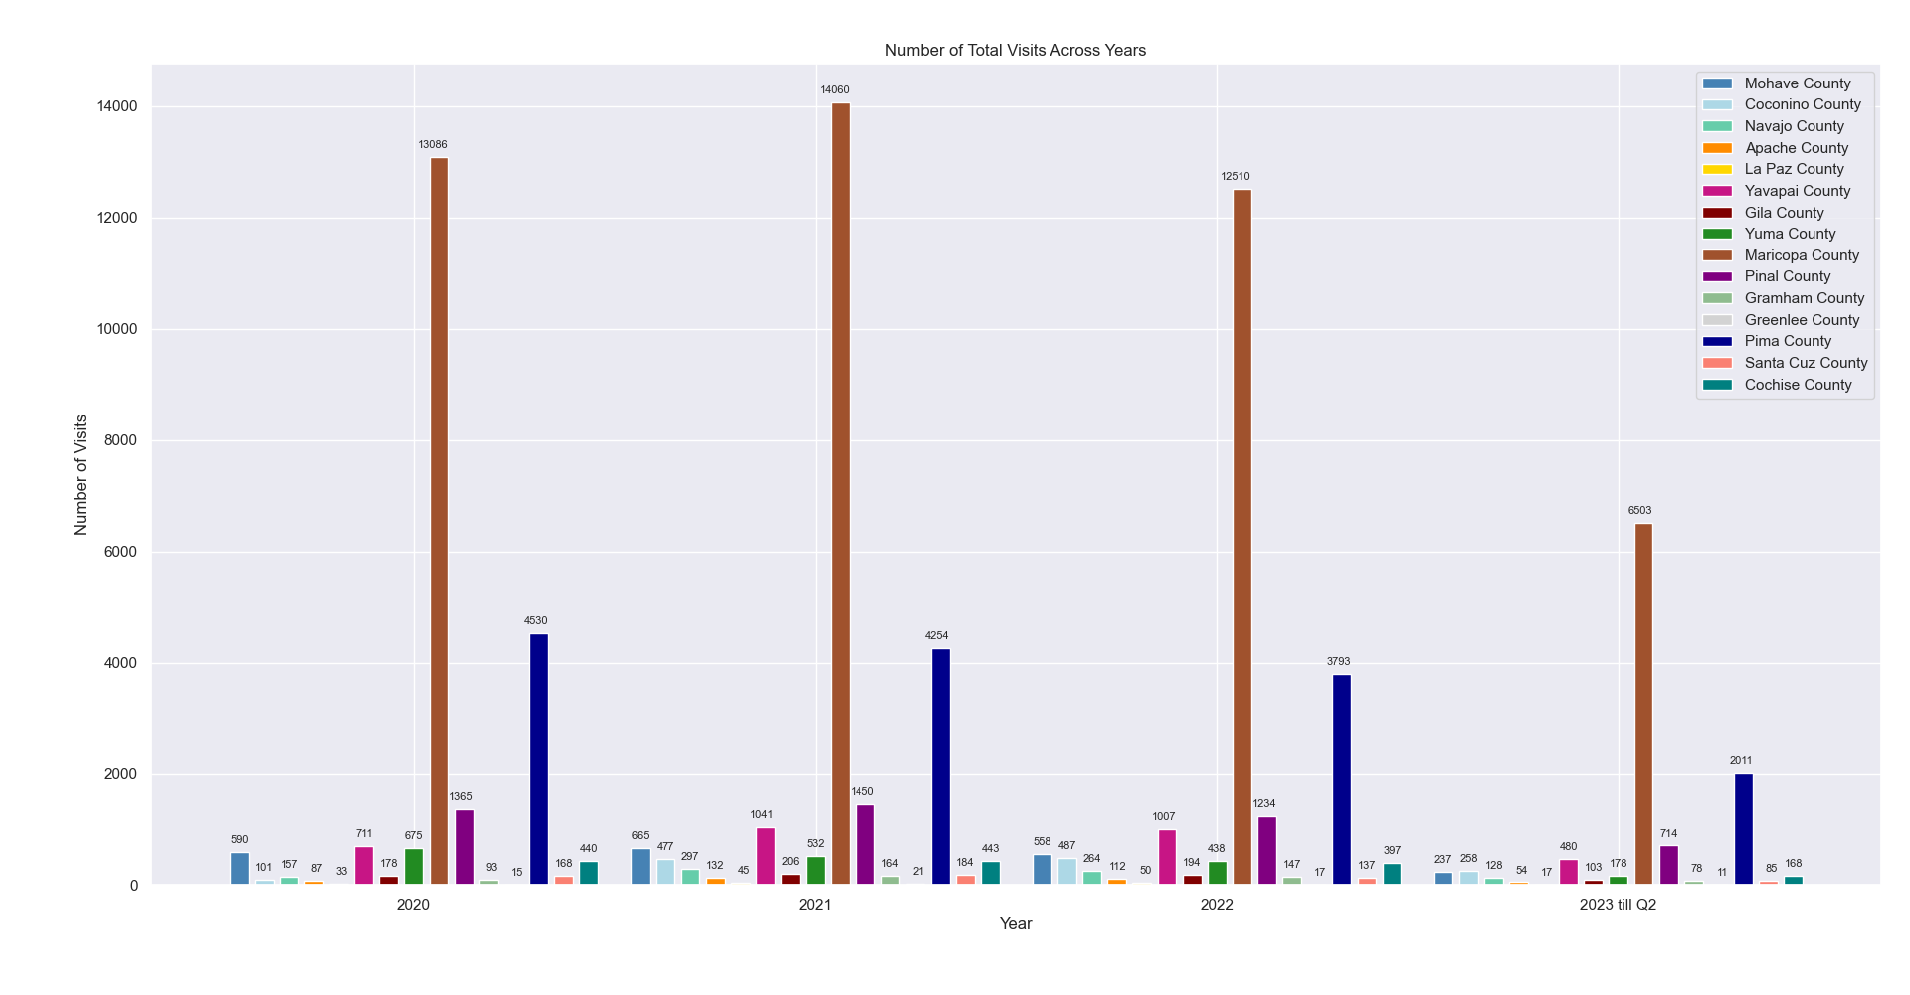
The figure above shows the total visits (emergency + inpatient) for suspected drug overdoses across years, aggregated over different counties in Arizona.
Source: ADHS-Opioid Prevention

Slide 10
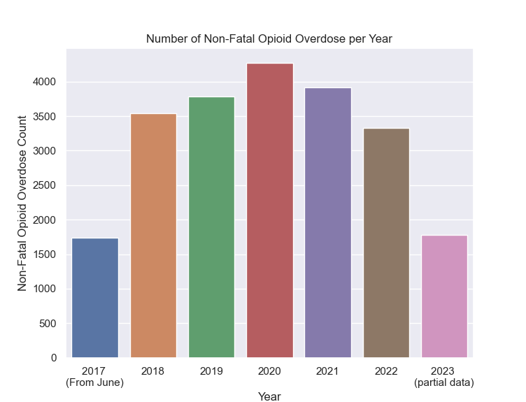
The figure above shows the number of verified non-fatal opioid overdose cases across years in Arizona.
Source: ADHS-Opioid Prevention

Slide 11
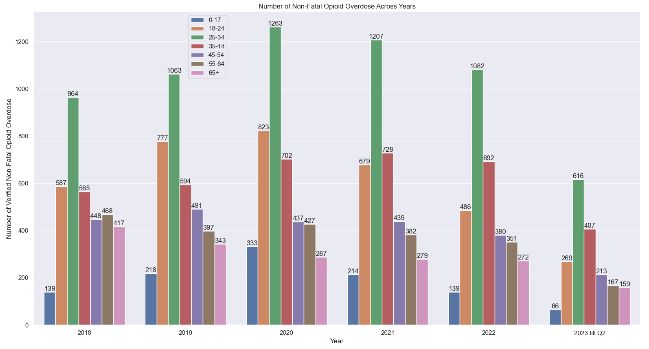
The figure above shows the number of verified non-fatal opioid overdose cases across years in Arizona, aggregated over different age categories.
Source: ADHS-Opioid Prevention

Slide 12
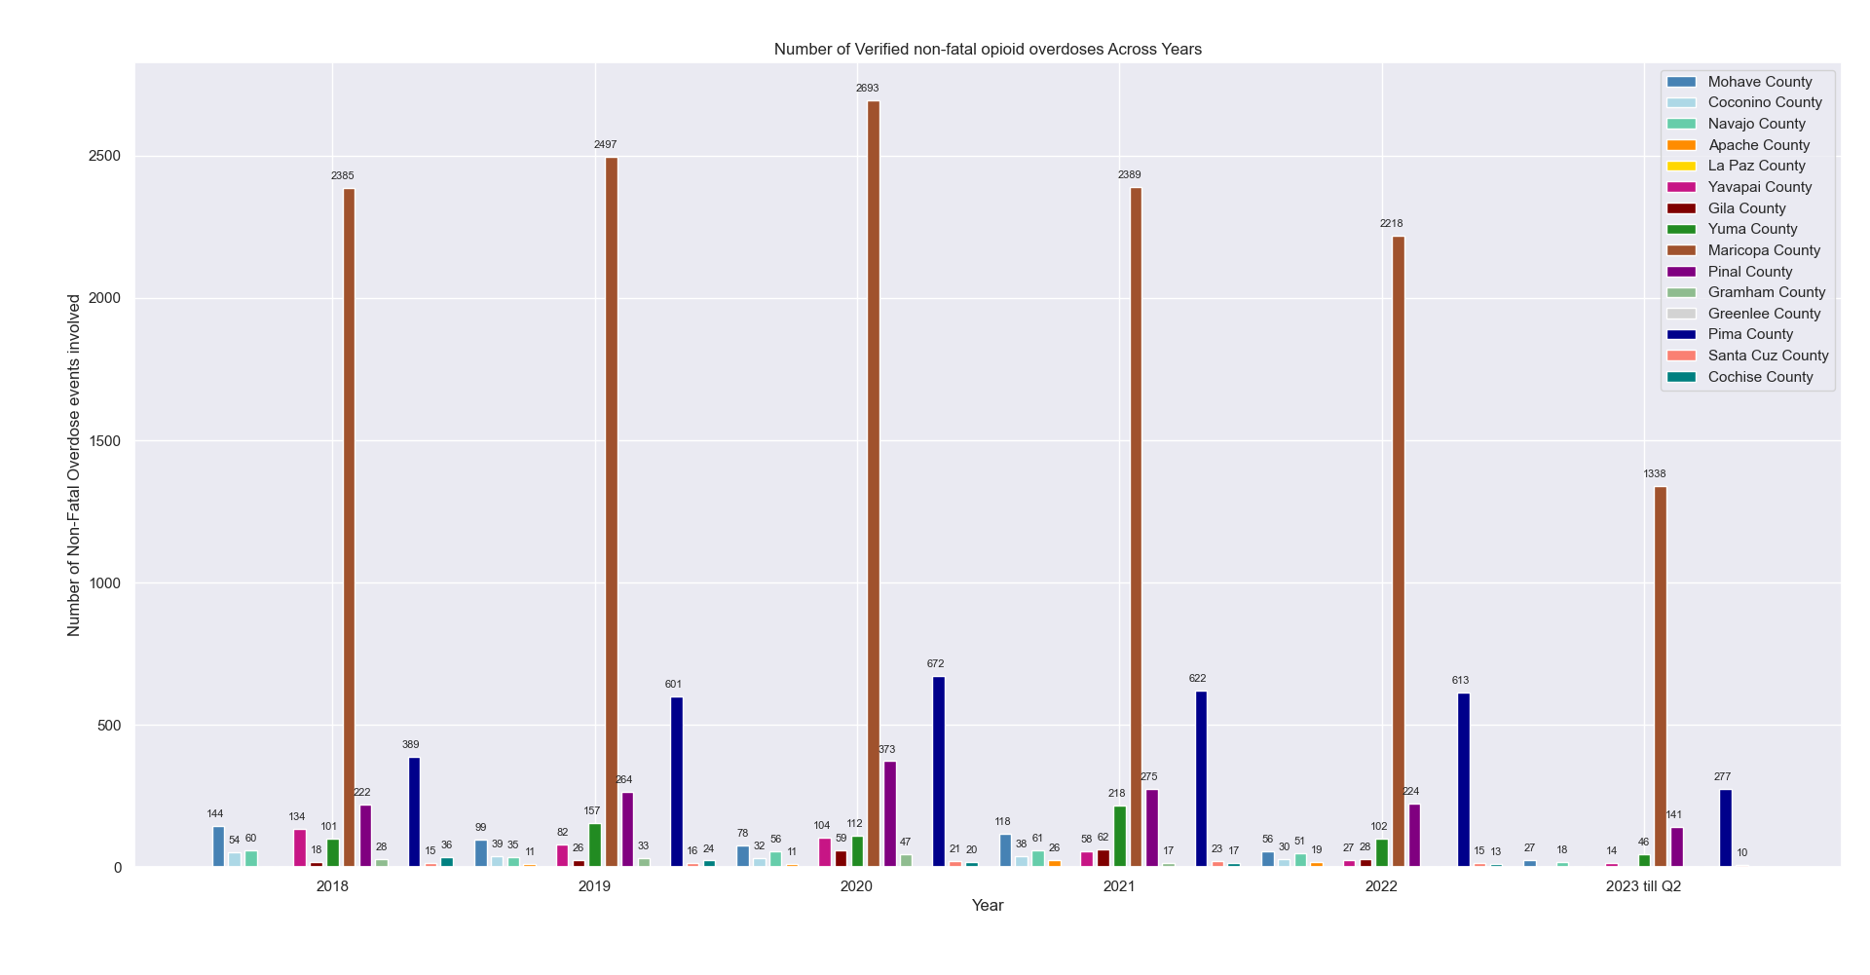
The figure above shows the number of verified non-fatal opioid overdose cases across years, aggregated over different counties in Arizona.
Source: ADHS-Opioid Prevention

Slide 13
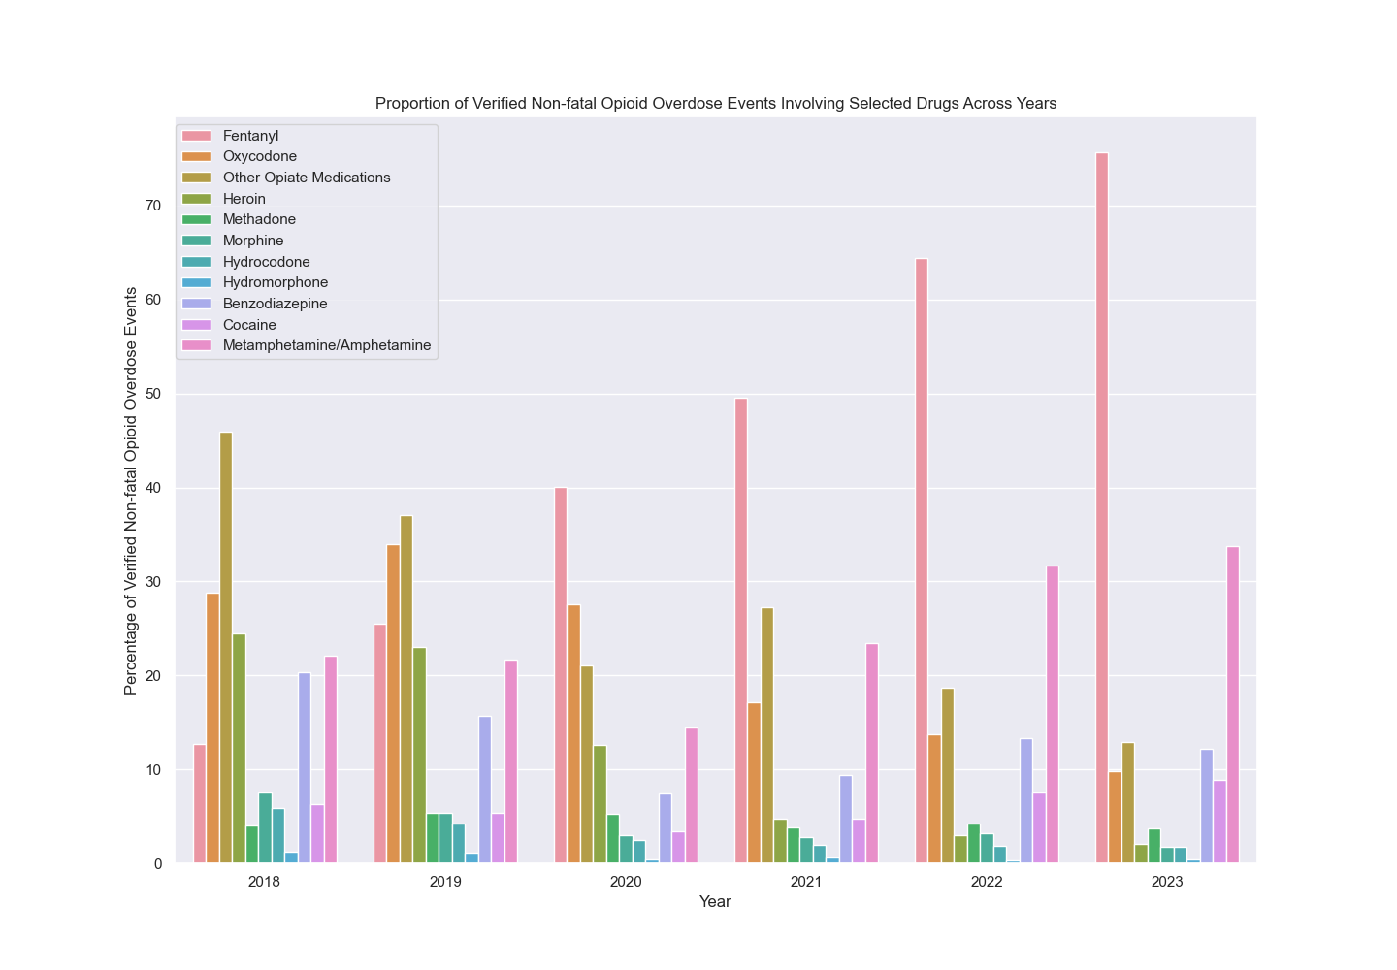
The figure above shows the proportion of verified non-fatal opioid overdose events involving selected drugs across years, in Arizona.
Source: ADHS-Opioid Prevention

Slide 14
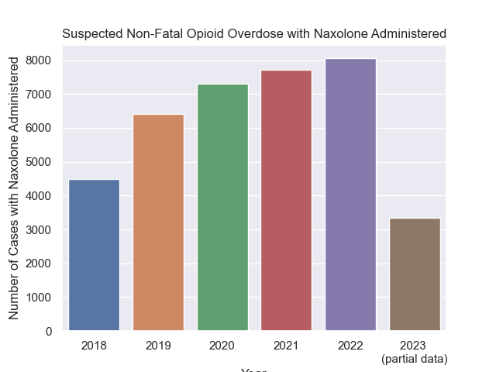
Years
The figure above shows the number of suspected non-fatal opioid overdoses with Naloxone administered across years in Arizona.
Source: ADHS-Opioid Prevention

Slide 15
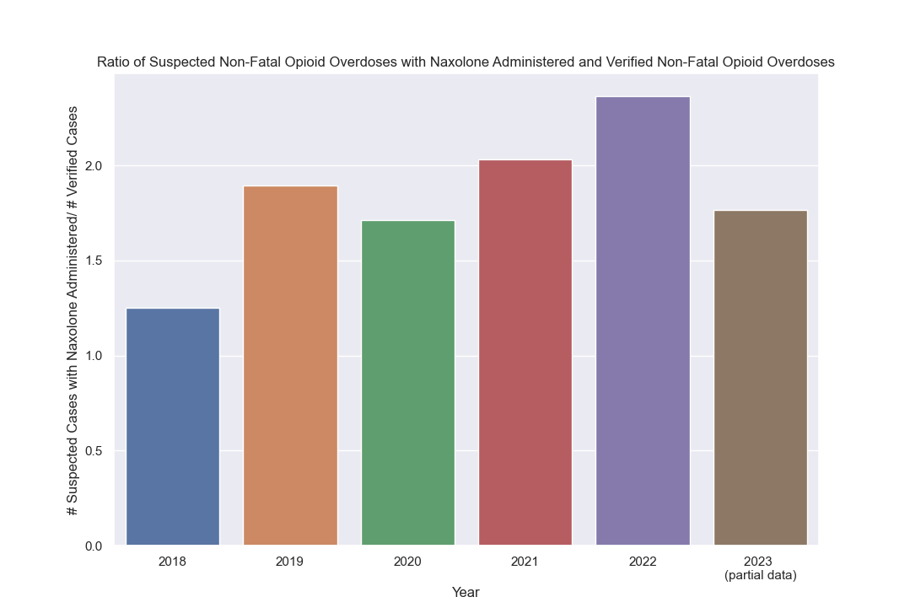
The figure above shows the ratio of the verified non-fatal opioid overdose cases with the suspected non-fatal overdose cases administered with naloxone, across years in Arizona.
Source: ADHS-Opioid Prevention

Slide 16
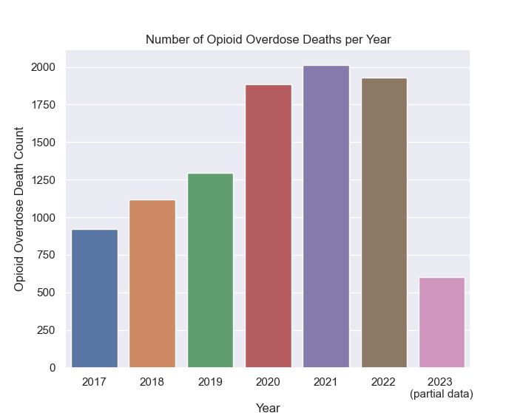
The figure above shows the number deaths potentially caused by opioid overdoses across years in Arizona.
Source: ADHS-Opioid Prevention, CDC

Slide 17
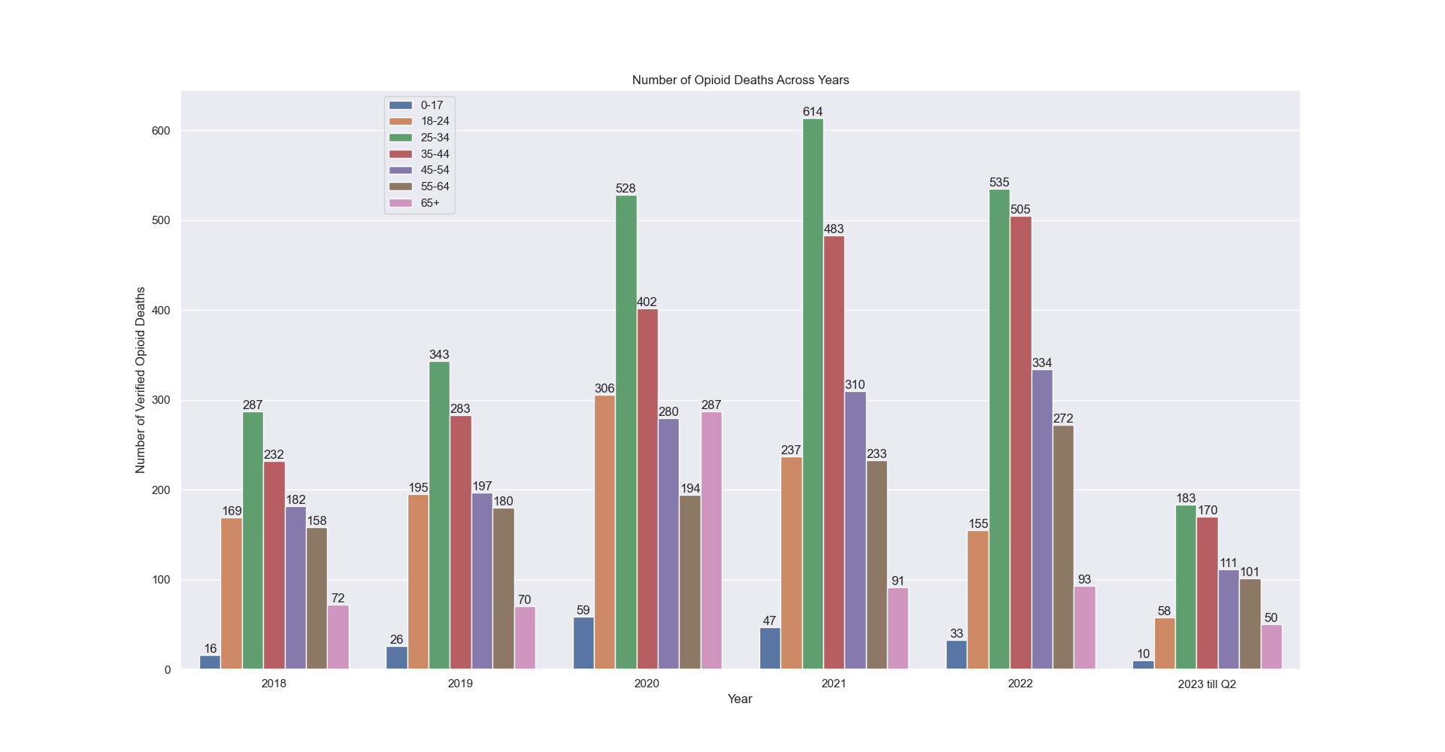
The figure above shows the number of deaths potentially caused by opioid overdoses across years in Arizona, aggregated over different age categories.
Source: ADHS-Opioid Prevention, CDC

Slide 18
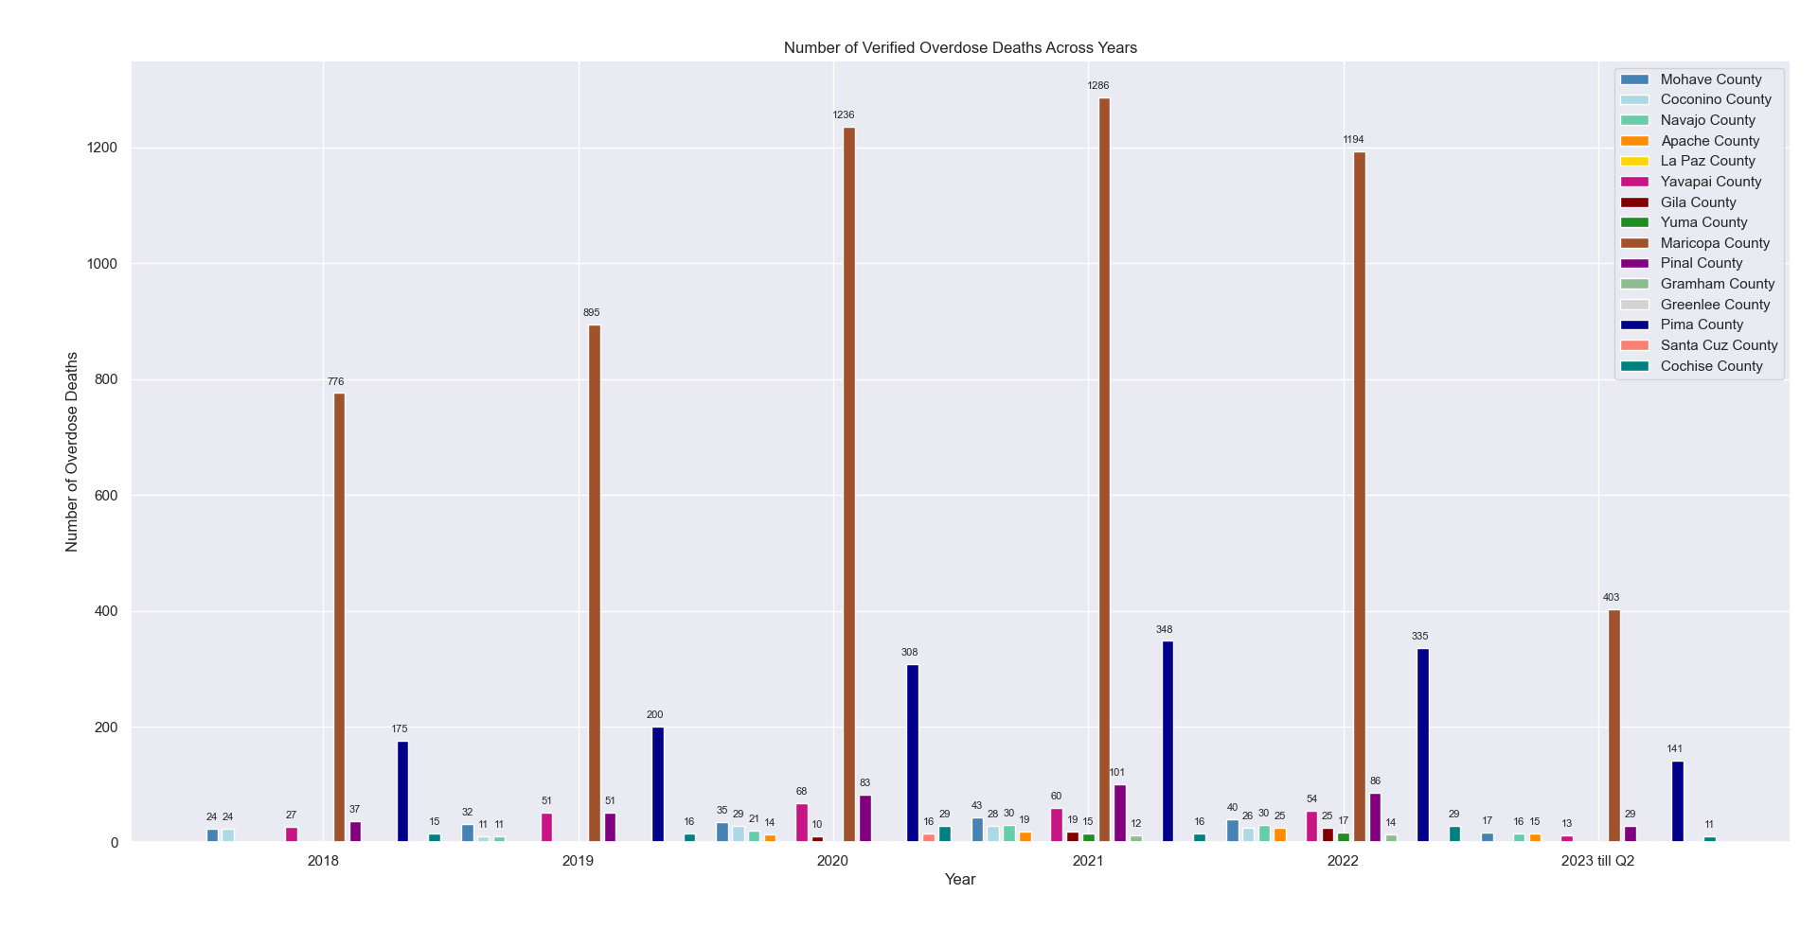
The figure above shows the number of deaths potentially caused by opioid overdoses across years, aggregated over different counties in Arizona.
Source: ADHS-Opioid Prevention, CDC

Slide 19
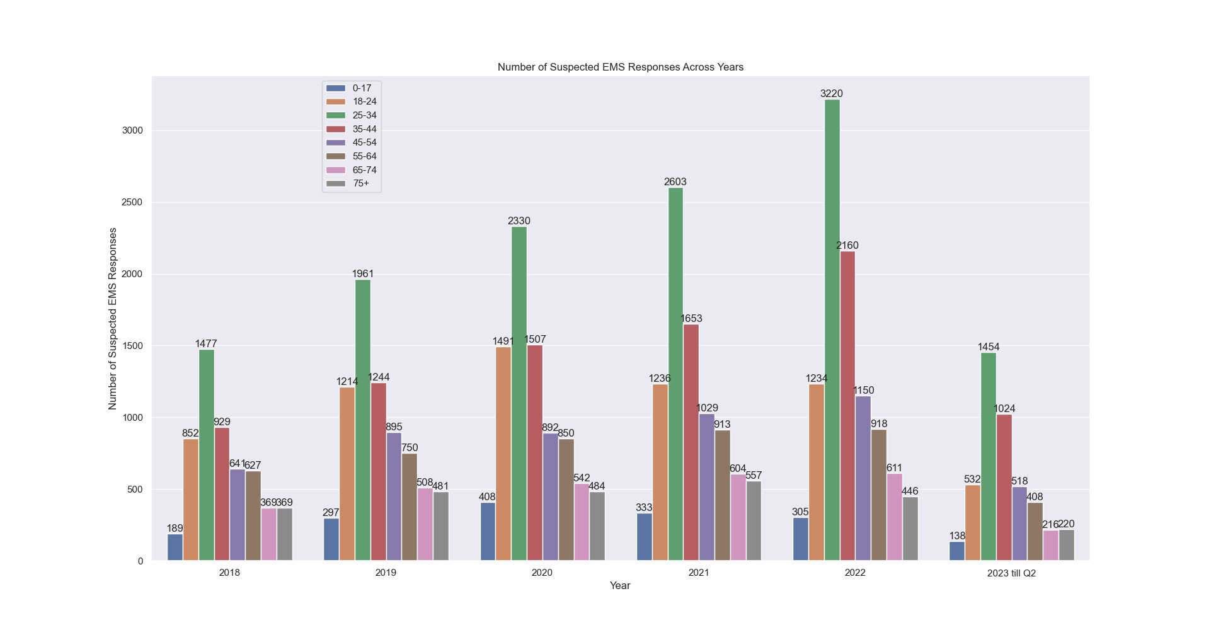
The figure above shows the number of EMS/Law enforcement responses for suspected opioid overdoses across years in Arizona, aggregated age categories.
Source: ADHS-Opioid Prevention

Slide 20
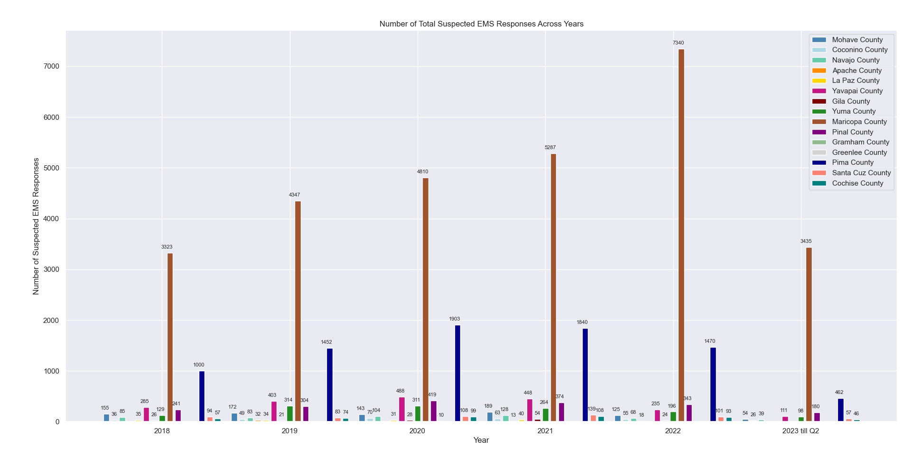
The figure above shows the number of EMS/Law enforcement responses for suspected opioid overdoses across years, aggregated over different counties in Arizona.
Source: ADHS-Opioid Prevention

Slide 21
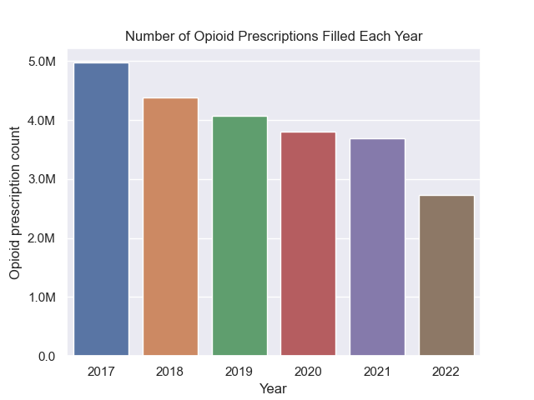
The figure above shows the number of opioid prescriptions filled across years in Arizona.
Source: Arizona Prescription Monitoring Program (PMP)

Slide 22
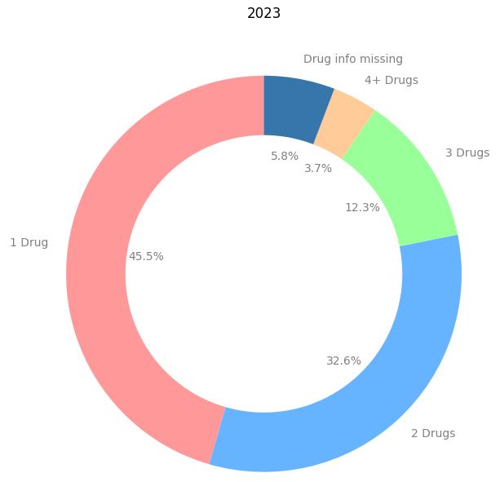
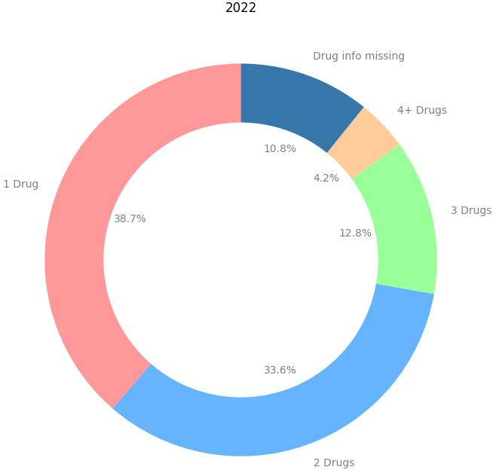
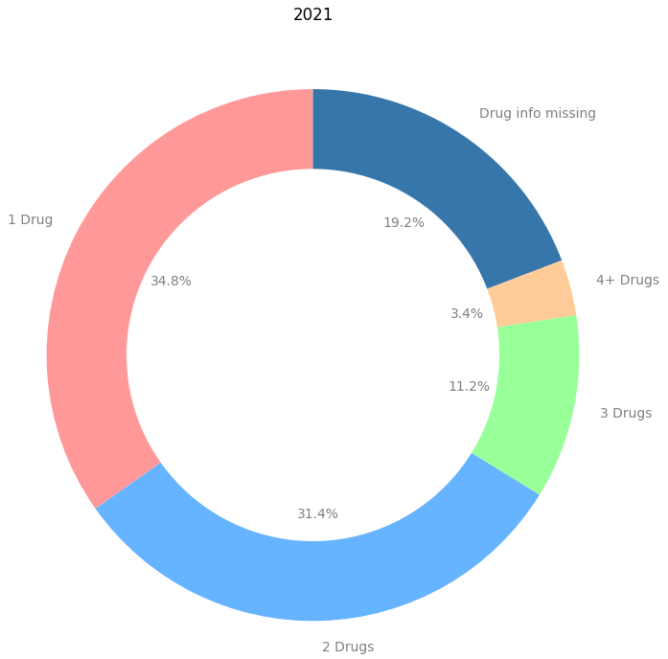
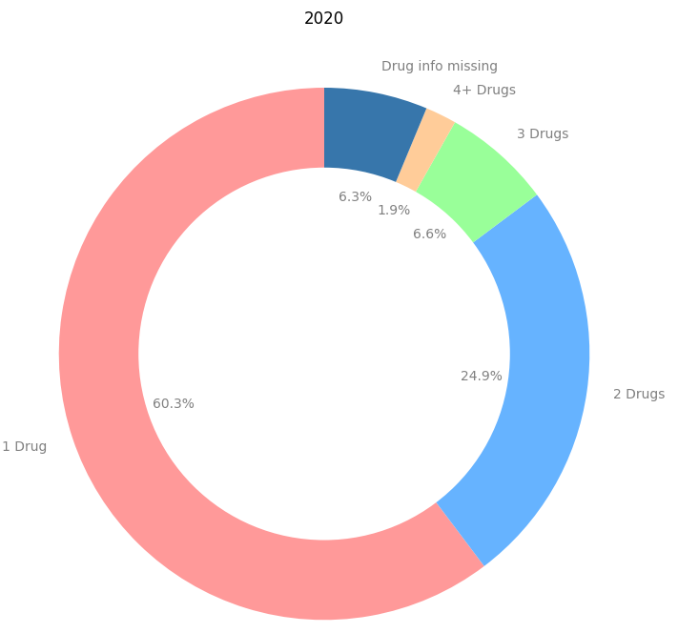
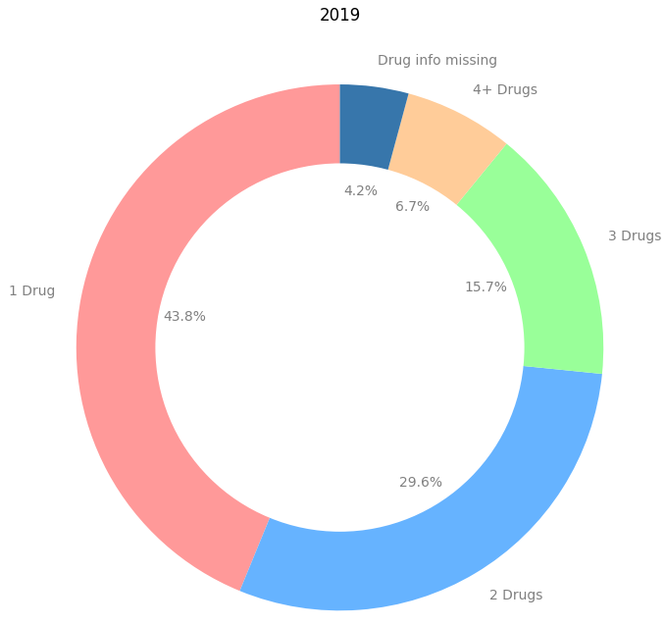
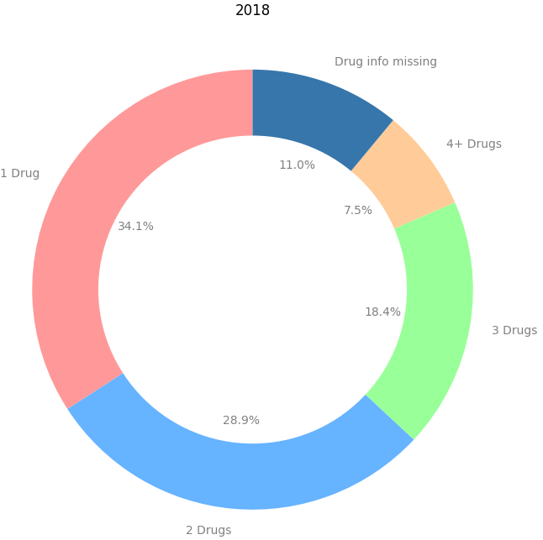
Proportion of verified non-fatal opioid overdose events involving selected number of drugs, across years in Arizona.
Source: ADHS-Opioid Prevention

